Slide 1


PANIMALAR ENGINEERING COLLEGE
DEPARTMENT OF ARTIFICIAL INTELLIGENCE AND DATA SCIENCE
FINAL PROJECT VIVA VOICE
21AD1811 –PROJECT
AUTOMATED QUESTION BUILDER APPLICATION USING GEN-AI
TEAM MEMBERS:
NILA D (211421243111)
NITHYA SHREE K (211421243113)
ARTHI R (211421243016)
PROJECT SUPERVISOR:
Dr. M.S. MAHARAJAN, M.E., Ph.D.,
Associate Professor
Department of AI&DS

Slide 2
INDEX
ABSTRACT
OBJECTIVE
EXISTING SYSTEM
PROPOSED SYSTEM
REQUIREMENT ANALYSIS
SYSTEM ARCHITECTURE
PROPOSED METHODOLOGY
RESULTS AND IMPLEMENTATION
CONCLUSIONS AND FUTURE ENHANCEMENT

Slide 3
ABSTRACT:
This project introduces an automated question generator application that leverages advancements in generative AI, using Groq’s Lemma API, large language models (LLMs), and natural language processing (NLP). The tool can dynamically generate various question types—such as multiple-choice, coding, and paragraph-based questions—tailored to input themes and complexities. This automated approach enhances educational content creation, making it efficient, contextually relevant, and cost-effective. The study highlights how generative AI can revolutionize educational technologies, supporting personalized learning and streamlined content production.

Slide 4
OBJECTIVE:
Develop a system capable of automatically generating educational questions to save time and reduce manual effort.
Groq’s Lemma API helps to process text quickly and efficiently, making AI responses faster.
Large Language Models (LLMs) generate human-like text, allowing the tool to create different types of questions (e.g., multiple-choice, coding, paragraph-based).
Natural Language Processing (NLP) ensures that the generated questions are meaningful, relevant, and grammatically correct.
This project helps create educational content quickly, customizes it for different learners, and reduces costs, making learning easier and more efficient.

Slide 5
LITERATURE REVIEW:
AUTHORS | PAPER TITLE | YEAR OF PUBLICATION | METHOD USED | ADVANTAGE | DISADVANTAGE
Sahil Kale Et.al | . FAQ-Gen: An automated system to generate domain-specific FAQs to aid content comprehension | 2024 | Text-to-Text Transformation Models Modular Pipeline Approach | Improved Accuracy Domain-Specific Adaptability | High Computational Cost Limited Generalization
Lala Septem Riza Et.al | Automatic generation of short‑answer questions in reading comprehension using NLP and KNN | 2023 | Natural Language Processing (NLP) K-Nearest Neighbor (KNN) | Faster Question Generation Improved Question Quality | Grammar Limitations Computational Overhead

Slide 6
LITERATURE REVIEW:
AUTHORS | PAPER TITLE | YEAR OF PUBLICATION | METHOD USED | ADVANTAGE | DISADVANTAGE
Puneeth Thotad Et.al | Automatic Question Generator Using Natural Language Processing | 2022 | Natural Language Processing (NLP) with SpaCy and NLTK Sense2Vec for Distractor Generation | Efficient MCQ Generation Enhances Learning and Self-Assessment | Limited Question Types Dependence on Input Quality
Pritam Kumar Mehta Et.al | Automated MCQ Generator using Natural Language Processing | 2021 | BERT Algorithm for Summarization WordNet for Distractor Generation | Fast and Efficient MCQ Generation High-Quality Distractors | Dependence on Text Quality Computationally Expensive

Slide 7
EXISTING SYSTEM:
In “traditional educational systems”, question creation is a manual, time-intensive process where educators design static question banks with limited formats, mainly multiple-choice or short-answer. This approach lacks adaptability for personalized learning and fails to support diverse question types, making it costly and difficult to scale effectively.
DISADVANTAGES:
Manually created questions can become outdated and are difficult to revise.
Traditional systems do not provide immediate feedback, delaying learning improvements.
Static questions don’t easily support adaptive assessments.

Slide 8
PROPOSED SYSTEM:
“Automated question generator” that uses Groq's Lemma API and generative AI to create diverse educational questions, including multiple-choice and coding formats. It tailors questions to specific topics and complexity levels, enhancing learning while reducing time and costs. This innovative approach aims to improve the quality and effectiveness of educational assessments..
ADVANTAGES:
Easily generates large volumes of questions for varying class sizes.
Provides immediate feedback for quick corrections.
Supports various assessment formats to boost engagement.

Slide 9
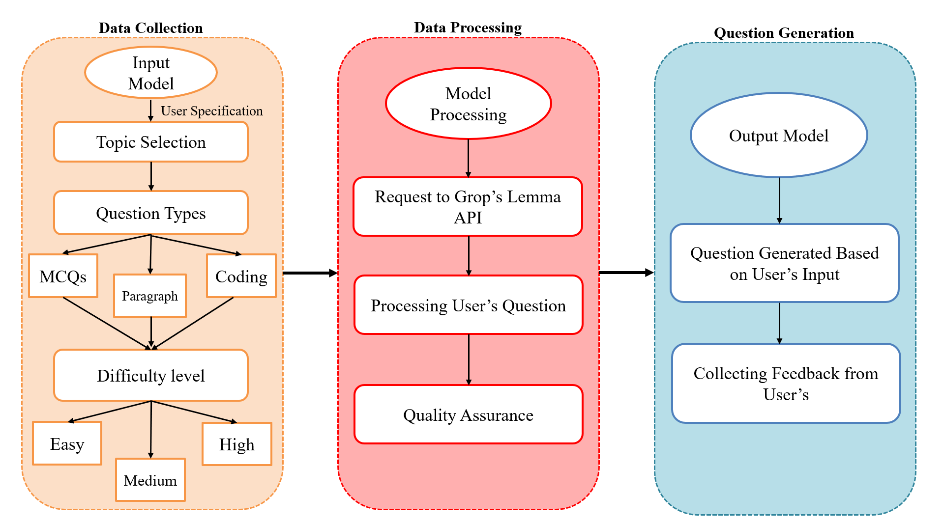
SYSTEM ARCHITECTRE:

Slide 10
PROPOSED METHODOLOGY :
Identify key requirements for the automated question generator, including question types and complexity.
Choose appropriate tools like Groq's Lemma API and NLP frameworks for implementation.
Gather educational content for training the language models.
Train and fine-tune models to enhance question generation quality.
Implement algorithms to generate various question types based on user inputs.
Create a user-friendly interface for educators to input topics and retrieve questions.
Conduct testing to evaluate question quality and gather feedback for improvements. Deploy the application in an educational environment, ensuring that it is accessible to users and providing necessary training.
Continuously monitor the system's performance and user feedback, making iterative improvements to enhance functionality and adapt to changing needs.

Slide 11
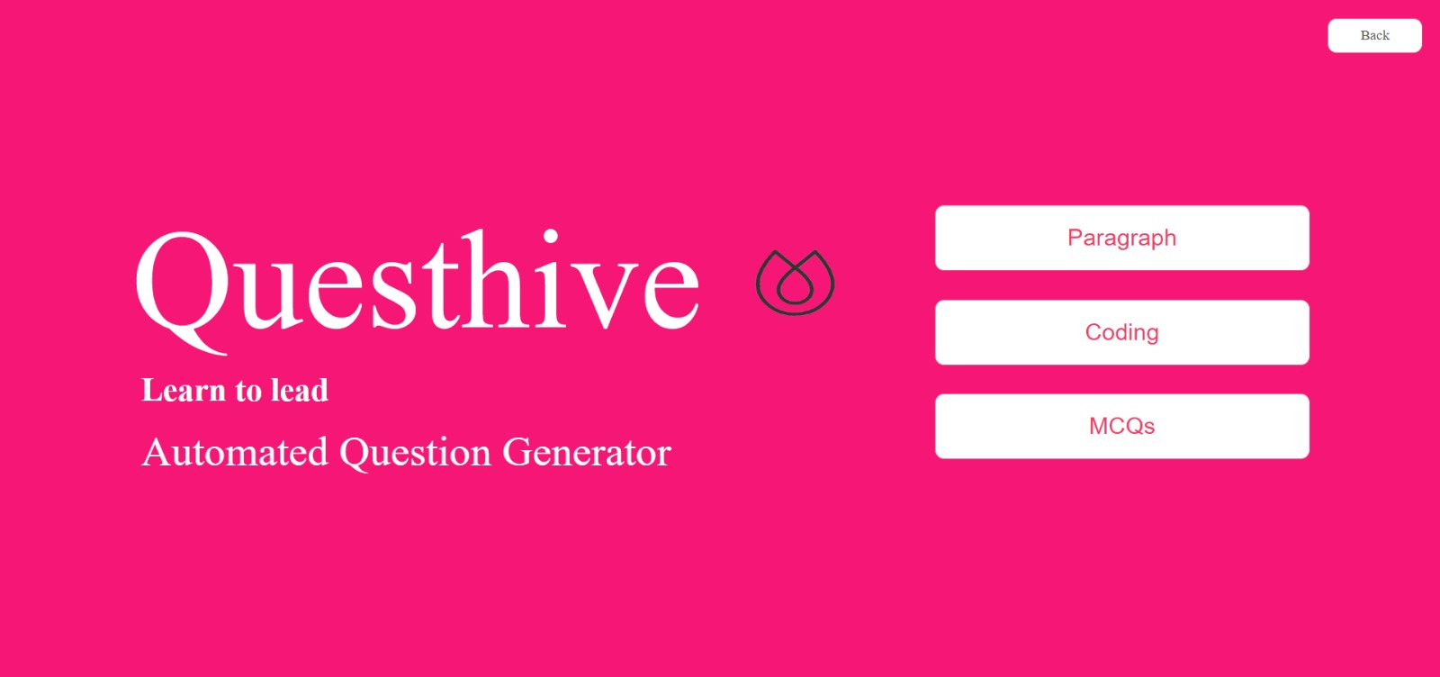

Slide 12
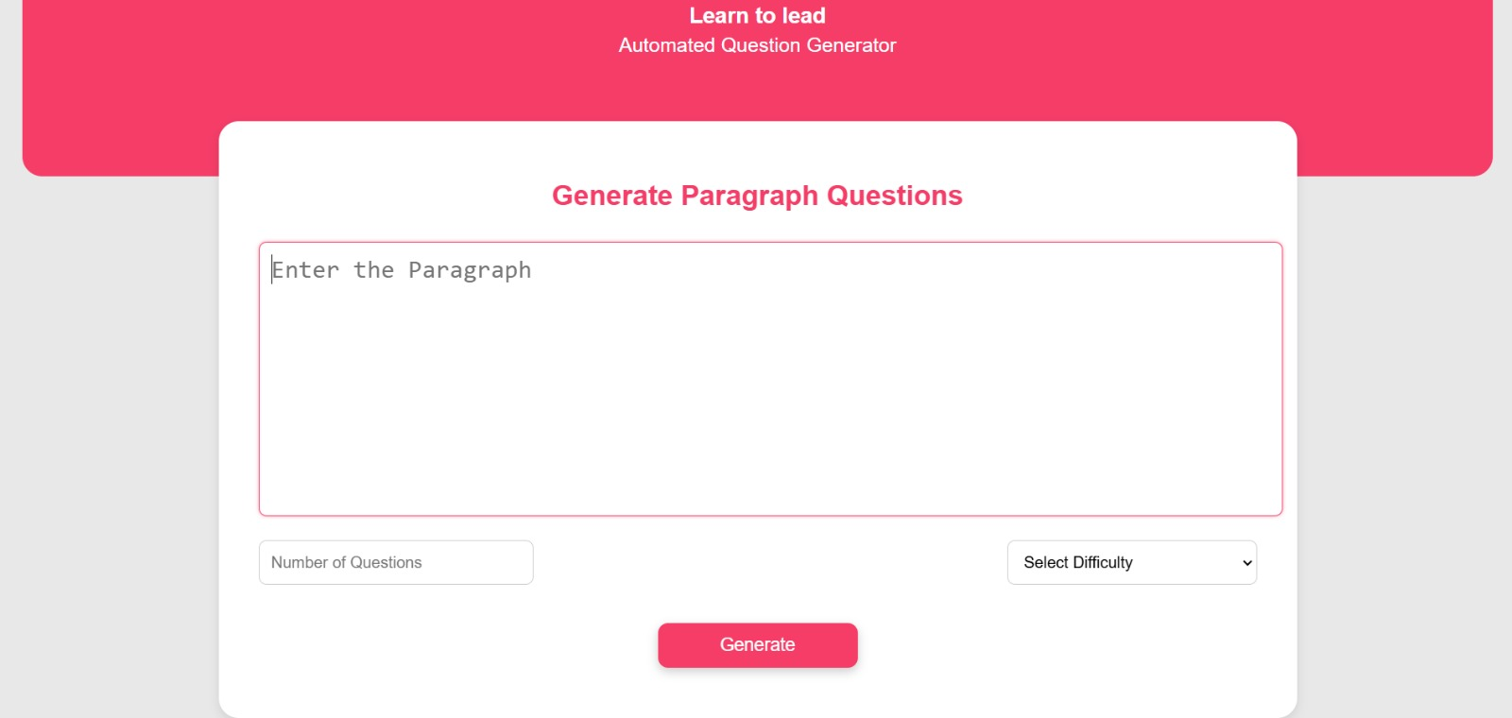

Slide 13
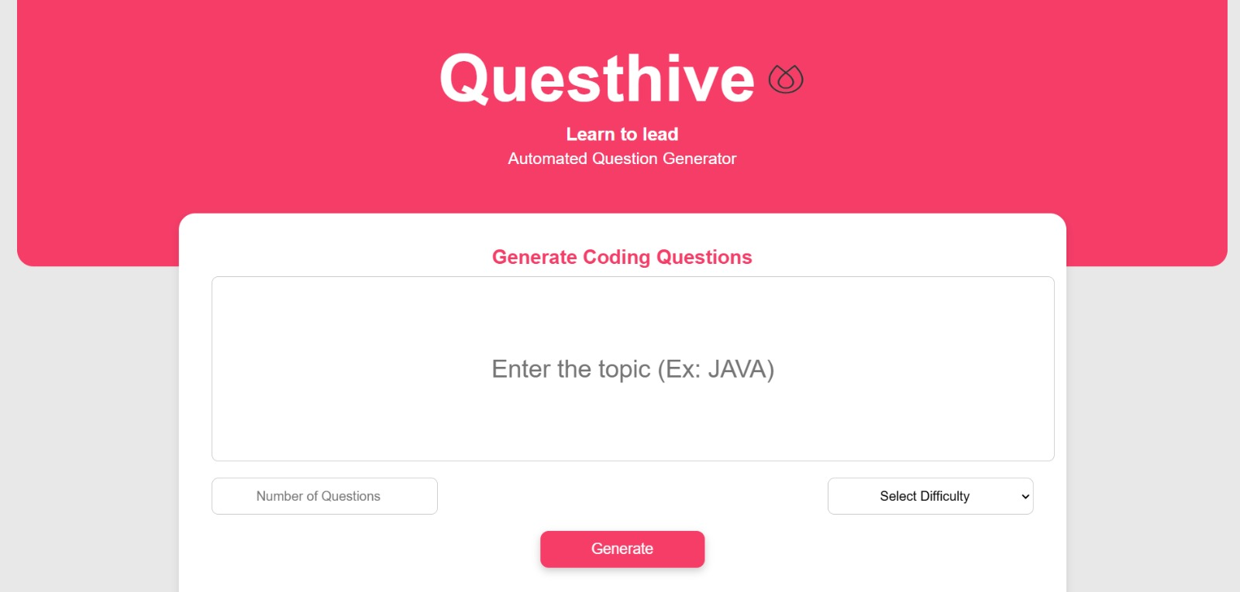

Slide 14
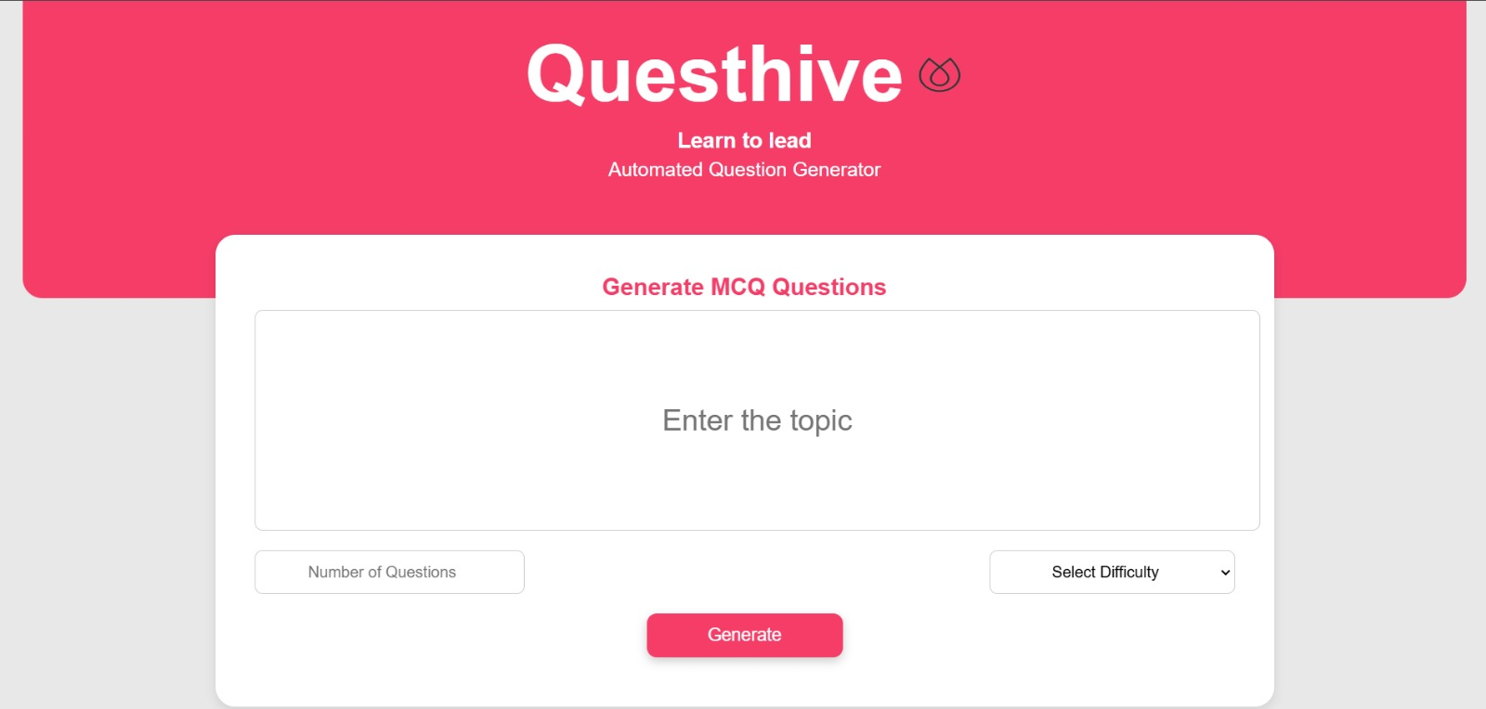

Slide 15
THANK YOU…..

